Slide 1



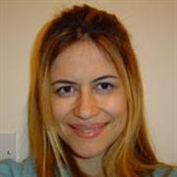
Cluster Contrast for Unsupervised Visual Representation Learning
Nikolaos Giakoumoglou nikos@imperial.ac.uk
Tania Stathaki t.stathaki@imperial.ac.uk

Slide 2
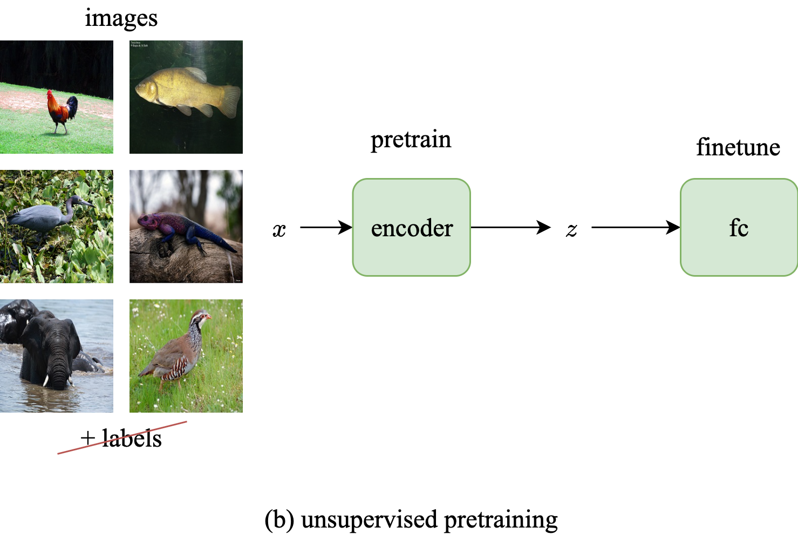
Unsupervised Learning of Visual Features
train end-to-end
y
optimize cross-entropy loss
using labels y
+ labels
(a) Supervised training

Slide 3
Unsupervised Learning of Visual Features
pretrain
solve a pretext task using pseudo labels
+ labels
(b₁) Unsupervised training

Slide 4

Unsupervised Learning of Visual Features
pretrain
freeze
+ labels
(b₂) Unsupervised training
Post training finetuning

Slide 5
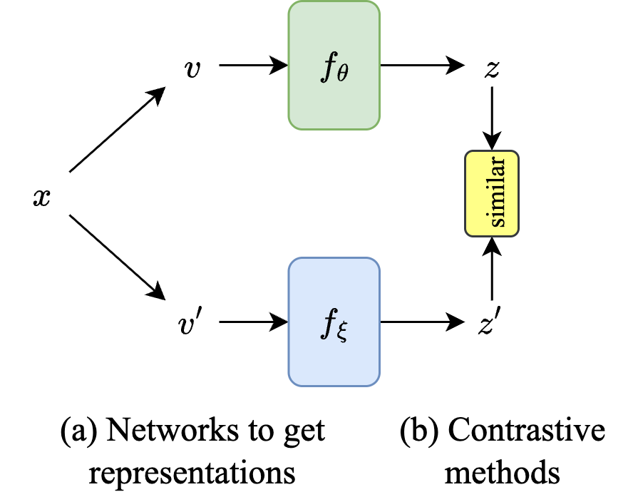
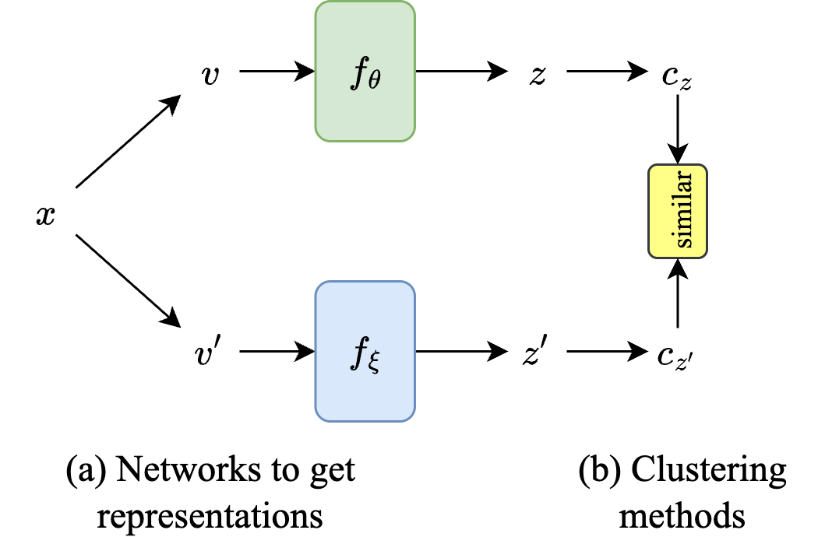
Related Work
SimCLR (https://arxiv.org/abs/2002.05709)
MoCo (https://arxiv.org/abs/1911.05722)
SwAV (https://arxiv.org/abs/2006.09882)
SMoG (https://arxiv.org/abs/2207.06167)

Slide 6
Related Work
SimCLR (https://arxiv.org/abs/2002.05709)
MoCo (https://arxiv.org/abs/1911.05722)
SwAV (https://arxiv.org/abs/2006.09882)
SMoG (https://arxiv.org/abs/2207.06167)

Slide 7
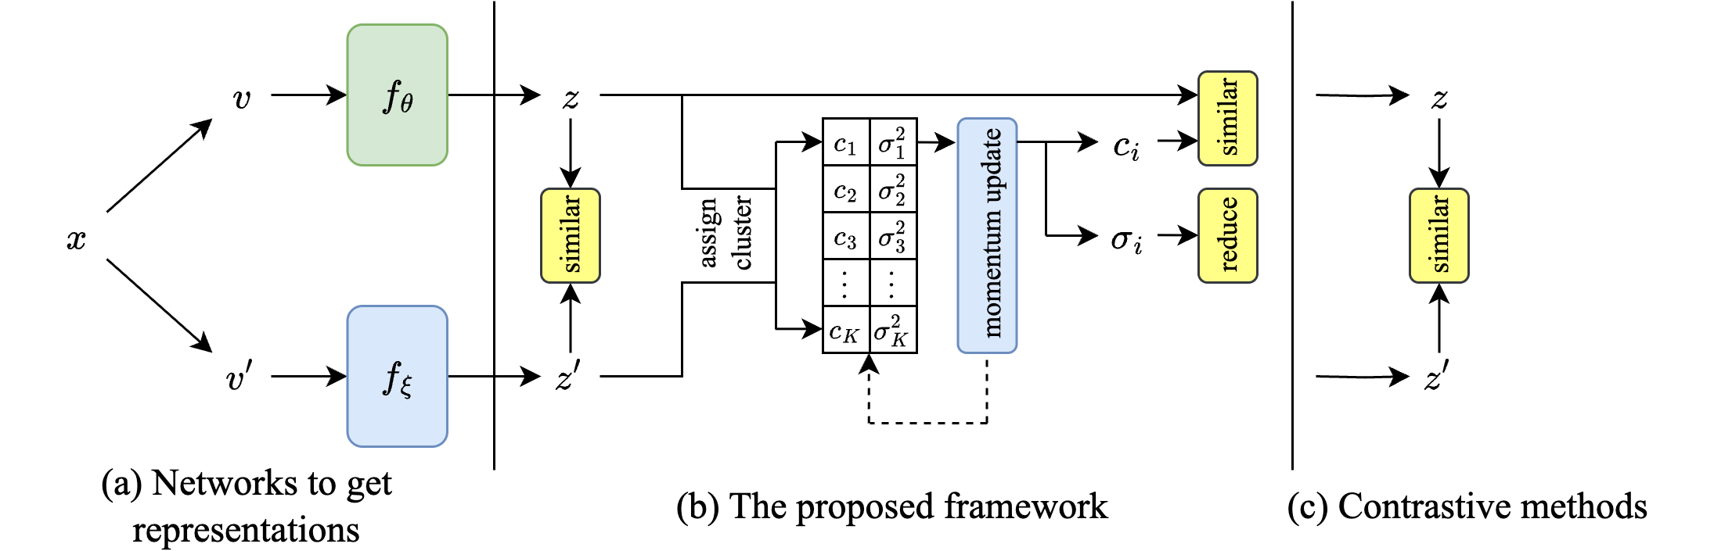
CueCo: Cluster Contrast

Slide 8
CueCo: Cluster Contrast
Contrastive term

Slide 9
CueCo: Cluster Contrast
Contrastive term
Centroid term

Slide 10
CueCo: Cluster Contrast
Contrastive term
Centroid term
Centroid variance term

Slide 11
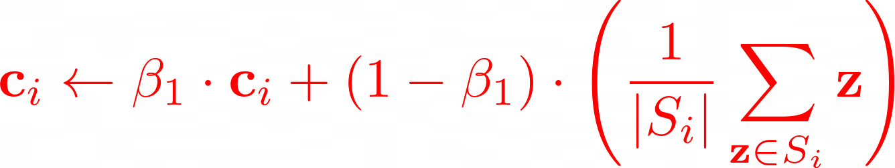
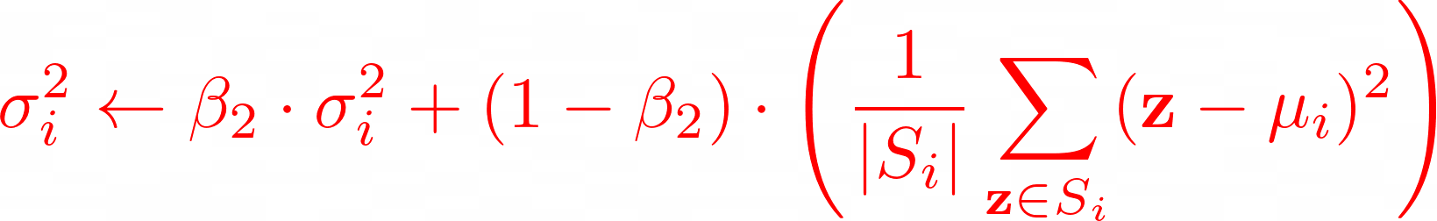
CueCo: Cluster Contrast
To address the limitations of static K-means, we use a momentum grouping scheme (from a queue) that continuously updates cluster centroids and stds during training

Slide 12
CueCo: Cluster Contrast

Slide 13
Advantages

Slide 14
Advantages

Slide 15
Advantages

Slide 16
Linear Evaluation
Method | CIFAR-10 | CIFAR-100 | ImageNet-100
MoCo-v3 | 93.10 | 68.83 | 80.86
MoCo-v2 | 92.94 | 69.54 | 78.20
BYOL | 92.61 | 70.18 | 80.09
SimCLR | 90.74 | 65.39 | 77.48
ReSSL | 90.63 | 65.83 | 76.59
SimSiam | 90.51 | 65.86 | 77.04
VICReg | 90.07 | 68.54 | 79.22
Barlow Twins | 89.57 | 69.18 | 78.62
DINO | 89.19 | 66.38 | 74.84
SwAV | 89.17 | 64.67 | 74.28
CueCo (ours) | 91.40 | 68.56 | 78.65
Table 1. Linear top-1 accuracies (%) obtained through linear evaluation protocol on CIFAR-10, CIFAR-100, and ImageNet-100 datasets using ResNet-18 as the backbone network

Slide 17
Linear Evaluation
Method | CIFAR-10 | CIFAR-100 | ImageNet-100
MoCo-v3 | 93.10 | 68.83 | 80.86
MoCo-v2 | 92.94 | 69.54 | 78.20
BYOL | 92.61 | 70.18 | 80.09
SimCLR | 90.74 | 65.39 | 77.48
ReSSL | 90.63 | 65.83 | 76.59
SimSiam | 90.51 | 65.86 | 77.04
VICReg | 90.07 | 68.54 | 79.22
Barlow Twins | 89.57 | 69.18 | 78.62
DINO | 89.19 | 66.38 | 74.84
SwAV | 89.17 | 64.67 | 74.28
CueCo (ours) | 91.40 | 68.56 | 78.65
Heavily tuned
Table 1. Linear top-1 accuracies (%) obtained through linear evaluation protocol on CIFAR-10, CIFAR-100, and ImageNet-100 datasets using ResNet-18 as the backbone network

Slide 18
Unsupervised Classification
Method | NMI | AMI | ARI | ACC
MoCo-v2 | 60.96 | 60.88 | 28.95 | 63.51
SimCLR | 69.03 | 68.98 | 53.14 | 74.50
CueCo (ours) | 69.33 | 69.01 | 53.87 | 75.06
Table 2a. Clustering Performance on CIFAR-10 (%)
Method | NMI | AMI | ARI | ACC
MoCo-v2 | 51.77 | 45.84 | 9.95 | 31.72
SimCLR | 50.75 | 44.60 | 11.15 | 32.17
CueCo (ours) | 52.37 | 46.31 | 11.35 | 33.82
Table 2b. Clustering Performance on CIFAR-100 (%)

Slide 19
Ablation Study
λ₁ | λ₂ | λ₃ | Top-1 | Top-5 | 20-NN | 100-NN | NMI | AMI | ARI | ACC
✓ |  |  | 67.9 | 90.7 | 66.5 | 66.4 | 50.5 | 44.4 | 8.3 | 31.1
✓ | ✓ |  | 66.9 | 90.6 | 63.9 | 62.4 | 54.6 | 48.6 | 14.9 | 34.5
✓ |  | ✓ | 68.4 | 90.7 | 66.7 | 66.8 | 51.2 | 45.1 | 8.6 | 32.3
✓ | ✓ | ✓ | 68.5 | 91.0 | 66.8 | 67.0 | 52.3 | 46.3 | 11.3 | 33.8
Table 3: Effect of active terms on performance metrics on CIFAR-100 (%)

Slide 20
Ablation Study
Centroid term
Contrastive term
Centroid variance term
λ₁ | λ₂ | λ₃ | Top-1 | Top-5 | 20-NN | 100-NN | NMI | AMI | ARI | ACC
✓ |  |  | 67.9 | 90.7 | 66.5 | 66.4 | 50.5 | 44.4 | 8.3 | 31.1
✓ | ✓ |  | 66.9 | 90.6 | 63.9 | 62.4 | 54.6 | 48.6 | 14.9 | 34.5
✓ |  | ✓ | 68.4 | 90.7 | 66.7 | 66.8 | 51.2 | 45.1 | 8.6 | 32.3
✓ | ✓ | ✓ | 68.5 | 91.0 | 66.8 | 67.0 | 52.3 | 46.3 | 11.3 | 33.8
Table 3: Effect of active terms on performance metrics on CIFAR-100 (%)

Slide 21
Thank you
Nikolaos Giakoumoglou nikos@imperial.ac.uk
Tania Stathaki t.stathaki@imperial.ac.uk
Paper: https://giakoumoglou.com/src/cueco.pdf
Presentation: https://giakoumoglou.com/src/cueco.pptx

